Slide 1




Semester Project
Aricia Pundt, Judah Williams, Ja' Leia Hathorn, Abraham Lopez-Gonzalez

Slide 2
The Application
We created a personal finance tracker using Python.
The user has several options when interacting with the application: add and view transactions, calculate transaction summary, categorize transactions, export and import transactions to csv, and exit the application.

Slide 3
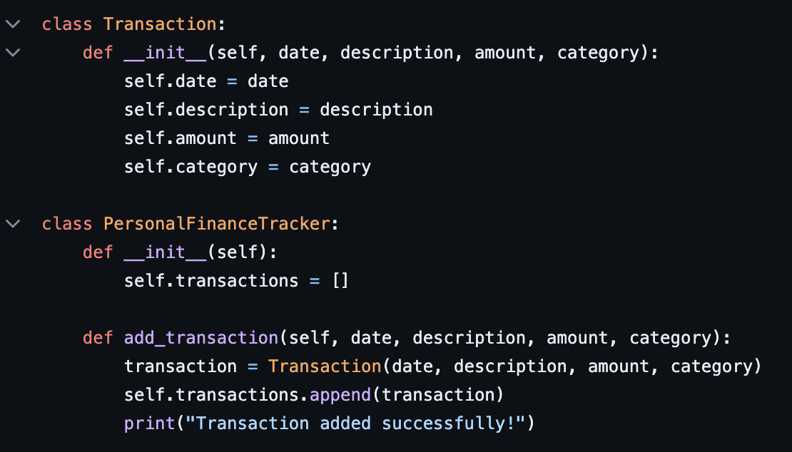
Meaningful Name Variables
Our project features the use of meaningful name variables to provide easily readable code and make sure the functionality is clear throughout the code.

Slide 4
Single Responsibility Principle
Our project adheres to the Single Responsibility Principle as well since our classes and methods all have a single functionality.
For example the ‘Transaction’ class encapsulates data regarding a single transaction and the ‘view_transactions’ method is responsible only for viewing transactions.

Slide 5
Consistent Formatting
Our code follows consistent formatting. The spacing and line length is consistent which aids in readability.
For example, f strings are used consistently throughout the project.

Slide 6
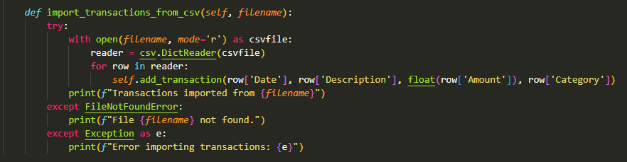
Error Handling
Our code features error handling with the use of try and except blocks as seen in the import_transactions_from_csv method.

Slide 7
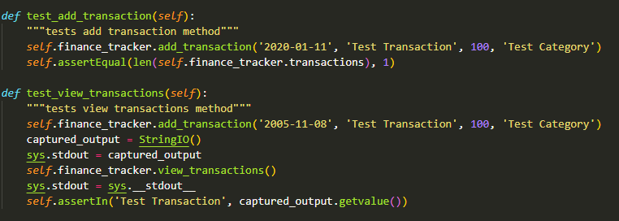
Testing
We created unit tests that thoroughly test each method present in the Personal Finance Tracker test.

